Slide 1
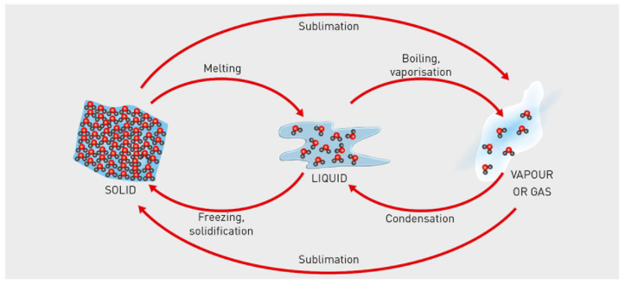
Concept Development
CFU 1
What three state changes involve an decrease in heat?
Substances can change between the three states by heating or cooling.
When substances are cooled, they lose energy.
When substances are heated, the gain energy.
INCREASING HEAT
CFU 2
What happens to the energy in a substance when it is cooled?
CFU 3
What is the phase change when a liquid becomes a solid?
Deposition
DECREASING HEAT

Slide 2
Skill Development/Guided Practice
CFU 1
What is the change of state?
Describing phase changes
Name the phase change.
Describe the change in energy (increase/decrease)
CFU 2
Is the energy increasing or decreasing?
Describe how a solid becomes a gas.
INCREASING ENERGY
A solid becomes a gas by _________.
The energy _______.
Deposition
DECREASING ENERGY

Slide 3
Skill Development/Guided Practice
CFU 1
What is the change of state?
Describing phase changes
Name the phase change.
Describe the change in energy (increase/decrease)
CFU 2
Is the energy increasing or decreasing?
Describe how a liquid becomes a gas.
INCREASING HEAT
A liquid becomes a gas by __________.
The energy _________.
Deposition
DECREASING HEAT

Slide 4
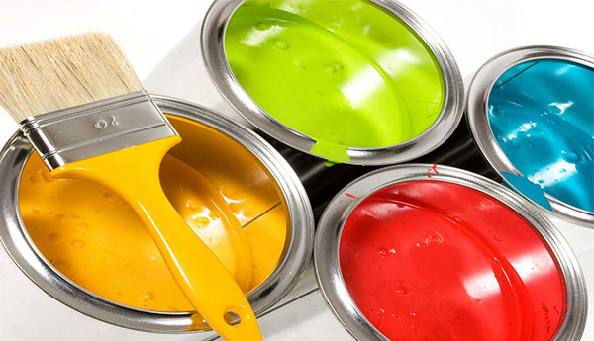
Daily Review
Mixtures are a combination of two or more substances.
Pure substances are materials that are not combined with anything else.
Tell your partner how is a mixture different to a pure substance?
Give two examples of mixtures.

Slide 5
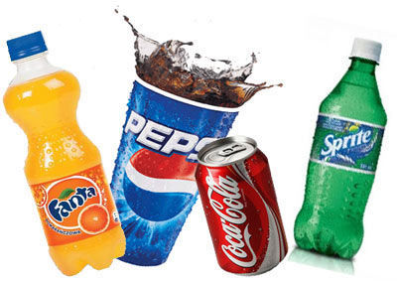
Daily Review
A solution is a mixture where one substance dissolves in another.
A suspension is a mixture where a substance doesn’t dissolve in a liquid and sinks to the bottom.
A colloid is a suspension that doesn’t separate over time
How is a solution different to a suspension?
Give one example of a suspension, solution and colloid

Slide 6
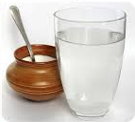
Daily Review
CFU 1
Is the substance dissolved or suspended?
Identifying a type of mixture.
1. Is one substance dissolved evenly = solution 2. Is one substance spread through out another? Will it settle out = suspension Will it stay suspended = colloid
CFU 2
What type of mixture is this?
Sugar in water
Sugar in water is a ______ because it is one substance _________in another.

Slide 7
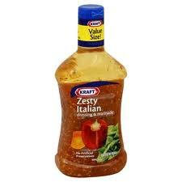
Daily Review
CFU 1
Is the substance dissolved or suspended?
Identifying a type of mixture.
1. Is one substance dissolved evenly = solution 2. Is one substance spread through out another? Will it settle out = suspension Will it stay suspended = colloid
CFU 2
What type of mixture is this?
Salad dressing
Salad dressing is a ______ because it is one substance _________in another and will _______.

Slide 8
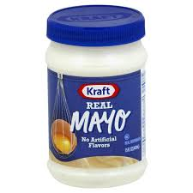
Daily Review
CFU 1
Is the substance dissolved or suspended?
Identifying a type of mixture.
1. Is one substance dissolved evenly = solution 2. Is one substance spread through out another? Will it settle out = suspension Will it stay suspended = colloid
CFU 2
What type of mixture is this?
Mayonnaise
Mayonnaise is a ______ because it is one substance _________in another and will _______.

Slide 9
Solutions

Slide 10
Learning Objective
CFU
What are we going to learn?
Describe the difference between soluble and insoluble substances
Identify the parts of a solution
Describe the concentration of a solution
Activate Prior Knowledge
On your whiteboard, write down an example of a mixture where one substance is dissolved in another.

Slide 11
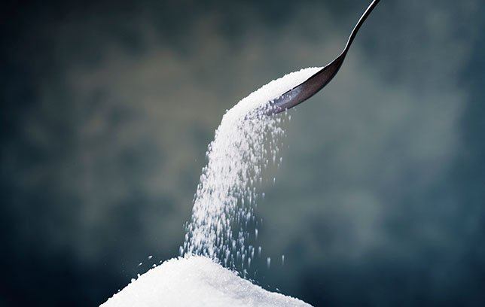
Concept Development
CFU 1
In your own words, what is a solution?
Soluble and Insoluble Substances
Solutions are formed when one substance dissolves in another
Soluble substances dissolve in a liquid
Insoluble substances don’t dissolve in a liquid.
Insoluble substances can not form solutions as they do not dissolve.
CFU 2
Sugar dissolves easily in water. Is sugar soluble or insoluble?
CFU 3
Name a substance that is insoluble in water?

Slide 12
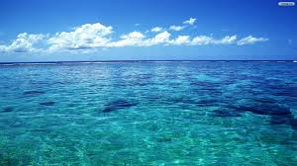
Concept Development
CFU 1
A cup of coffee is a solution of coffee powder in hot water. Identify the solvent and the solute.
Parts of a Solution
A solution has two parts:
the substance dissolving is called the solute
the liquid is called the solvent
For example in salty water
the salt is the solute
the water is the solvent
CFU 2
Name another solute that can be dissolved in a cup of coffee.

Slide 13
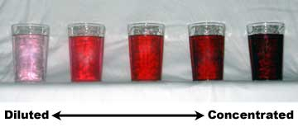
Concept Development
CFU 1
Which would have more solute in it, a glass of cordial or the concentrate in the bottle? Explain your choice.
Concentration
Solutions can be compared in terms of their concentration
A dilute solution only has a little solute dissolved
A concentrated solution has a lot of solute dissolved
If no more solute dissolves, the solution is saturated
CFU 2
Salt is dissolved in some water until no more will dissolve. What is the concentration of this solution called?
Vocabulary
Solute: The substance dissolving in a liquid

Slide 14
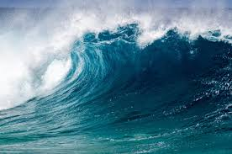
Skill Development / Guided Practice
CFU 1
What two substances are in seawater?
Describing a solution
Step 1 identify the substances in the solution
Step 2 identify which is the substance dissolving (solute)
Step 3 identify the liquid it has dissolved into (solvent)
CFU 2
Which substance is dissolving?
CFU 3
Which substance is the liquid it has dissolved into?
What is the solute and solvent in seawater?
The substances in seawater are salt and water.
Salt is the solute and water is the solvent.

Slide 15
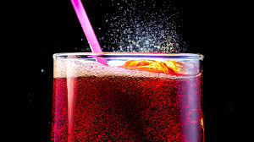
Skill Development / Guided Practice
CFU 1
What two substances are in soft drink?
Describing a solution
Step 1 identify the substances in the solution
Step 2 identify which is the substance dissolving (solute)
Step 3 identify the liquid it has dissolved into (solvent)
CFU 2
Which substance is dissolving?
CFU 3
Which substance is the liquid it has dissolved into?
What is the solute and solvent in soft drink?
The substances in soft drink are water and carbon dioxide (bubbles).
Carbon dioxide is the solute and water is the solvent.

Slide 16
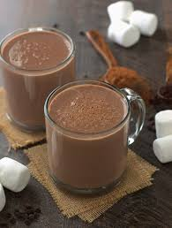
Skill Development / Guided Practice
CFU 1
What two substances are in hot chocolate?
Describing a solution
Step 1 identify the substances in the solution
Step 2 identify which is the substance dissolving (solute)
Step 3 identify the liquid it has dissolved into (solvent)
CFU 2
Which substance is dissolving?
CFU 3
Which substance is the liquid it has dissolved into?
What is the solute and solvent in hot chocolate?
The substances in hot chocolate are milk and chocolate powder.
________is the solute and ________is the solvent.

Slide 17
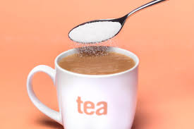
Skill Development / Guided Practice
CFU 1
What two substances are in sweet tea?
Describing a solution
Step 1 identify the substances in the solution
Step 2 identify which is the substance dissolving (solute)
Step 3 identify the liquid it has dissolved into (solvent)
CFU 2
Which substance is dissolving?
CFU 3
Which substance is the liquid it has dissolved into?
Sugar is sometimes added to tea to make it sweeter.
What is the solute and solvent in sweetened tea?
The substances in tea are ________ and ________.
________is the solute and ________is the solvent.

Slide 18
Relevance
Solutions are a mixture where one substance dissolves in another.
Knowing how to identify the parts of a solution will help you work out ways to separate them into pure substances.
Knowing about the concentration of a solution will help you understand why solutions with a large amount of solute will taste stronger than ones with less.

Slide 19
Skill Closure
What is the difference between a soluble substance and an insoluble substance?
Skill Closure
A cup of coffee is a solution. Identify the solvent and the solute in this solution.
Skill Closure
How would you make a concentrated solution more dilute?

Slide 20
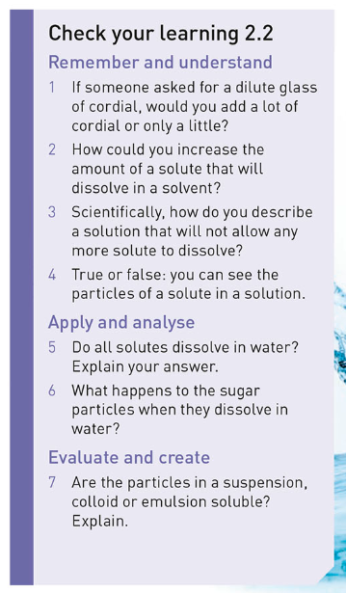
Independent Practice
Collect a copy of the text book
Open to page 31
Complete questions

